Slide 1

Third Sprint Release
Scrum approach

Slide 2
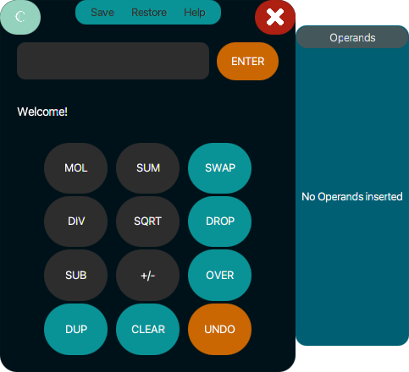
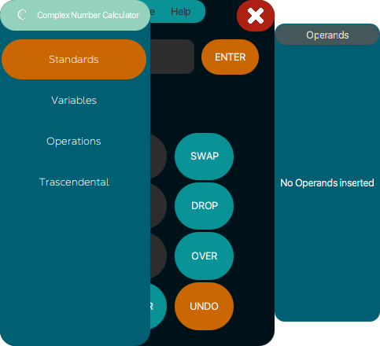
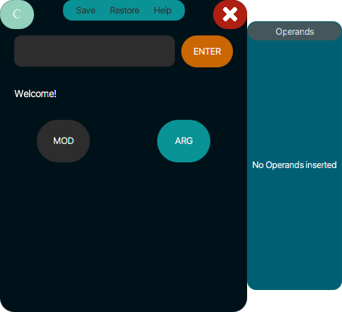
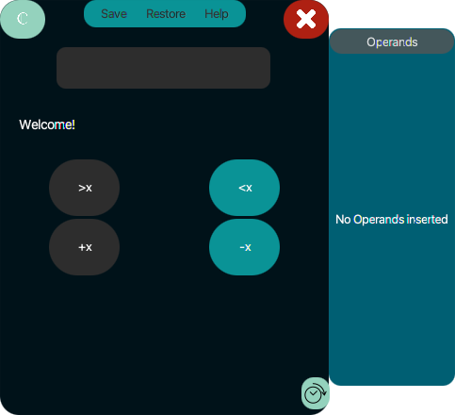
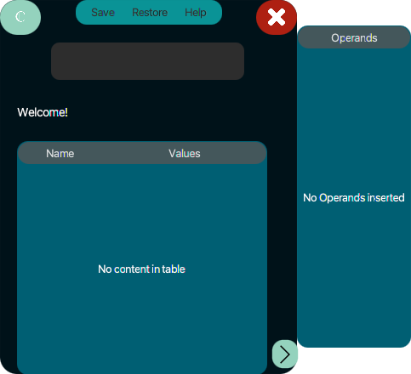
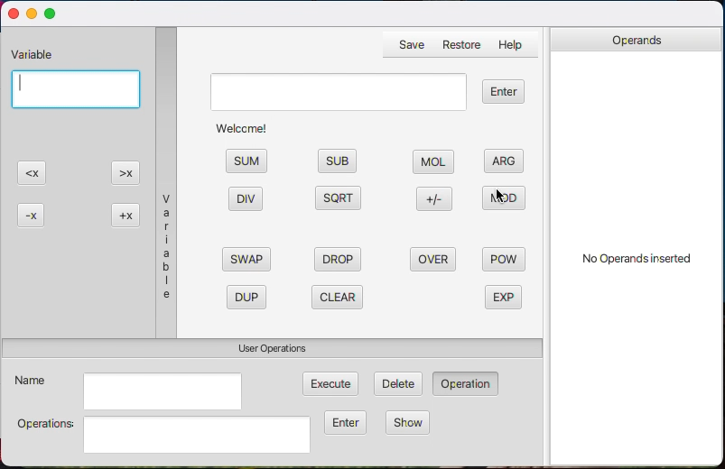
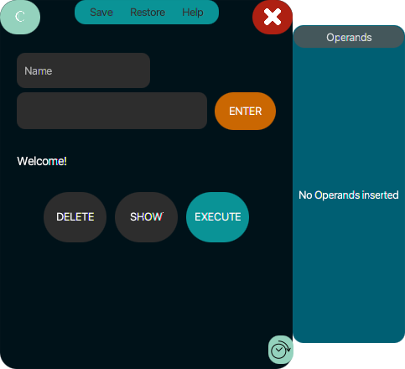
Potentially shippable increment
In the video there is a short demonstration of the system working. The calculator, after the Third sprint, has been updated, allowing user to save to a file the user defined operations, restore them in another usage session, save different sets of variable's values, restore them and calculate the module and the argument of a complex number.
What we have
achieved
What we aspected to achieve

Slide 3
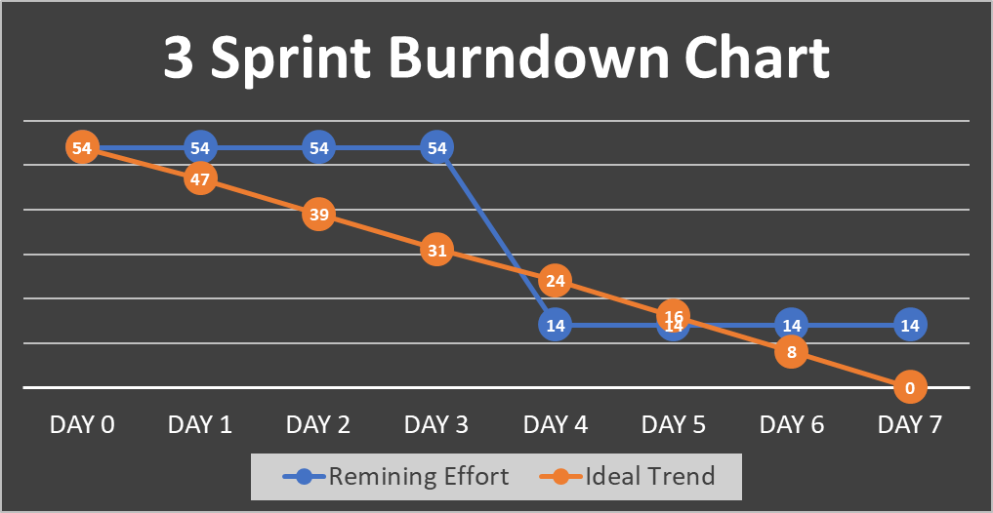
Third Sprint Burndown Chart
For this Sprint we decided to work for 54 story points, but to give priority, before this, to the code refactoring and the improvement of the graphical User Interface. These two activities took us five of each member's weekly working hours. It is the reason why we started to work to User Stories no earlier than the DAY4. Up to that moment we have dedicated ourselves to those two activities and therefore we have not accumulated anything in terms of Story Points associated with User Stories.
The Burndown chart of the Third Sprint.
During the Third Sprint w 14 of the 54 preset Story Points were not satisfied.

Slide 4







Sprint Review and Sprint Retrospective
Sprint Review
Sprint Retrospective
We discussed about the application of SCRUM methodology, and about what to improve and about what went well in the process
We discussed about the released product, the positive and negative aspects.
We discussed about the fact that the code refactoring and the user interface improvement took longer than expected.
START
STOP
MORE OF
LESS OF
KEEP DOING
We are satisfied because, in our opinion, the goal has been met.
See it
See it
THIRD SPRINT REVIEW REPORT
THIRD SPRINT RETROSPECTIVE REPORT

Slide 5
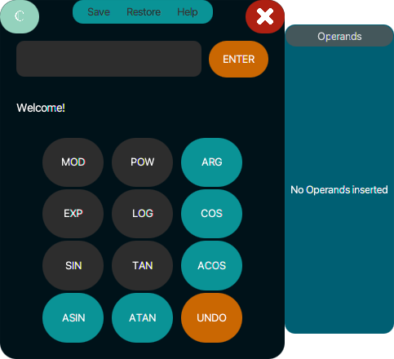
System architecture refinement
If there had been a possible fourth Sprint, the goal would have been to ensure that the calculator can also support transcendental operations not yet implemented ("pow", "exp", "log", "sin", "cos", "tan", "asin", "acos", "atan").
To support this possible other sprint, the refinement of the architecture we had arrived at for the Third Sprint would not have required any particular changes, with the exception of the introduction of new commands associated with these new features.
See it
Even the interface would not have undergone major changes, in fact in the dedicated "Trascendental" section only some buttons would have been introduced to allow user to perform new features.

Slide 6







Updated Product Backlog and Fourth Sprint Backlog
No changes were made to the product backlog which had already been fully explicited.
If there had been another Sprint, the Fourth Sprint Backlog would have been formed by the User Stories associated with the Third Sprint but which we were not able to solve and the other user stories that are present in the Product Backlog and not yet assigned to any Sprint, as they were those with lower priority.
FOURTH PRODUCT BACKLOG
ESTIMATED TEAM VELOCITY:
71 Story Points
FOURTH SPRINT BACKLOG:
71 Story Points
The 17 next high priority User Stories
See it
See it

Slide 7
Thanks for the attention

